Slide 1
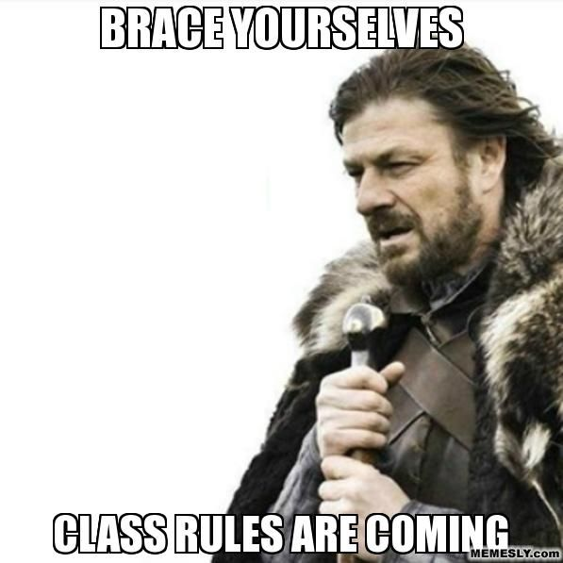
Class Expectations
Mrs. Sadek’s English Class

Slide 2
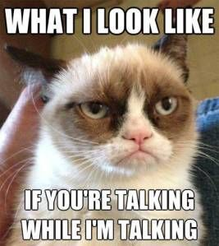
1. Be respectful. One person talks at a time. Don’t talk over anyone. (Especially Mrs. Sadek)

Slide 3
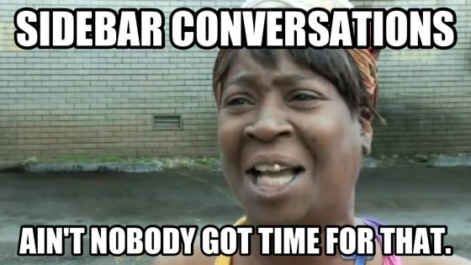
1. Be respectful. Pay Attention

Slide 4
1. Be respectful. Keep any personal drama outside of the classroom.

Slide 5
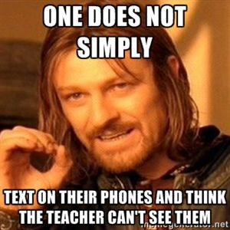
1.Be respectful. Put cell phones AWAY during instruction.

Slide 6
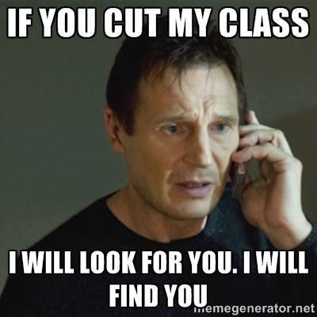
2. Be in class on time.

Slide 7
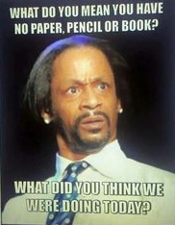
3. Come to class prepared.

Slide 8
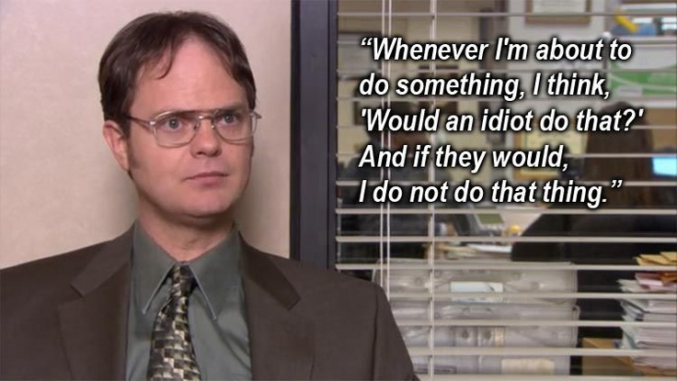
4. No bullying. Be the best version of yourself.

Slide 9
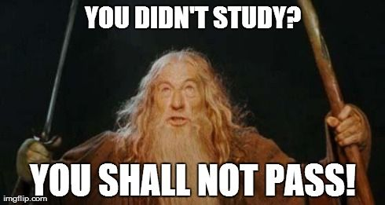
5. Do your best. The grade you receive is exactly the one you deserve.

Slide 10
English Procedures 1.Always write your name on your paper.

Slide 11
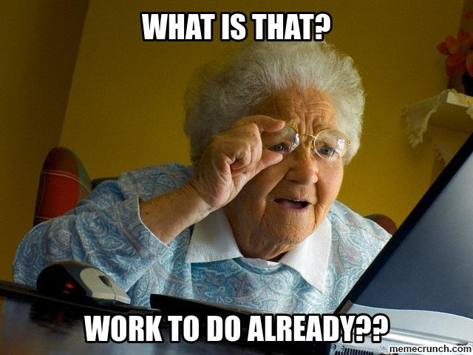
2. Use the first 5 minutes of class to get ready. (Warm up completed, get folder, sharpen pencil, etc.)

Slide 12
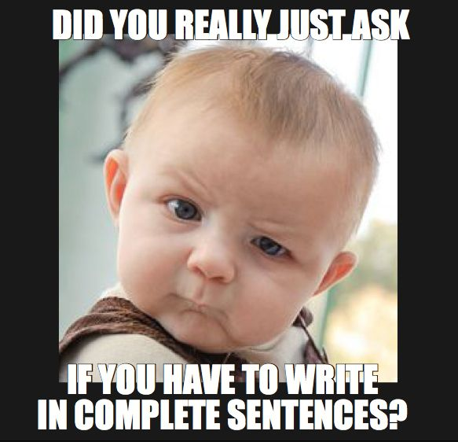
3. Unless you are told differently, always write in complete sentences.

Slide 13
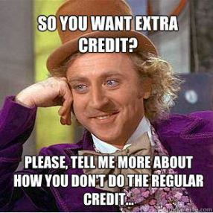
4. Complete assigned work on time.

Slide 14
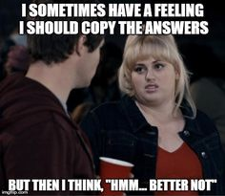
5. No plagiarism. Copying will result in a zero for all parties.

Slide 15
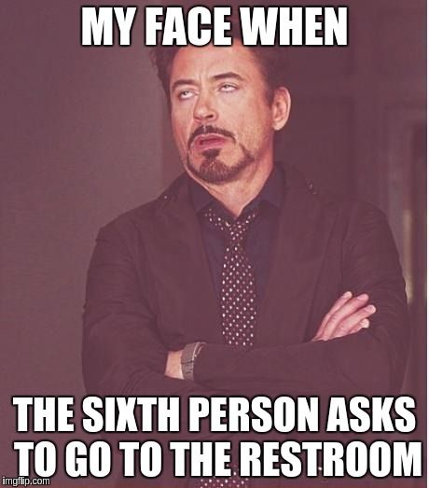
6. Use the bathroom when you absolutely have to go. If you’re not in the room you’re missing something important.

Slide 16
7. Appreciate privileges.

